Slide 1
Steady and Transient FMU Simulations in Simulink

Slide 2
Parameters
N° | Prameter | Value | Unit
1 | Anode_Inlet_Diameter_mm | 20,00 | mm
2 | Anode_Outlet_Diameter_mm | 20,00 | mm
3 | Cathode_Inlet_Diameter_mm | 60,00 | mm
4 | Cathode_Outlet_Diameter_mm | 60,00 | mm
5 | Discretization_length_mm | 100,00 | mm
6 | Coolant_Inlet_Diameter | 50,00 | mm
7 | Coolant_Outlet_Diameter | 50,00 | mm
8 | Anode_Initial_Pressure_bara | 1,00 | bar
9 | Anode_Initial_Temperature_C | 40,00 | C
10 | Anode_Initial_H2_Vol_Frac | 0,90 | -
11 | Anode_Initial_RH_Frac | 0,50 | -
12 | Cathode_Initial_Pressure_bara | 1,00 | bar
13 | Cathode_Initial_Temperature_C | 50,00 | C
14 | Cathode_Initial_RH_Frac | 0,50 | -
15 | Coolant_Initial_Temperature_C | 68,238304 | C
16 | Coolant_Initial_Pressure_bara | 1,00 | bar
17 | Stack_Initial_Temperature_C | 70,00 | C
18 | Coolant_fluid | egl-5050

Slide 3
Inputs
simple_example
PC_data
N°c | Prameter | Value | Unit
1 | Anode inlet flow rate | 1 | g/s
2 | Anode inlet H2 mass fraction | 0,9 | -
3 | Anode inlet N2 mass fraction | 0 | -
4 | Anode inlet H2O VAP mass fraction | 0.1 | -
5 | Anode inlet H2O LIQ mass fraction | 0 | -
6 | Anode inlet temperature | 45 | C
7 | Cathode inlet flow rate | 80 | g/s
8 | Cathode inlet O2 mass fraction | 0.2 | -
9 | Cathode inlet N2 mass fraction | 0.7 | -
10 | Cathode inlet H2O VAP mass fraction | 0.1 | -
11 | Cathode inlet H2O LIQ mass fraction | 0 | -
12 | Cathode inlet temperature | 70 | C
13 | Coolant inlet temperature | 65 | C
14 | Anode outlet pressure | 2.1 | Bar
15 | Cathode outlet pressure | 1.9 | bar
16 | Coolant outlet pressure | 1.8 | bar
17 | Current | 250 | A
18 | Coolant inlet flow rate | 3000 | g/s
N°c | Prameter | Value | Unit
1 | Anode inlet flow rate | 1,928186 | g/s
2 | Anode inlet H2 mass fraction | 0,826055 | -
3 | Anode inlet N2 mass fraction | 0,0693 | -
4 | Anode inlet H2O VAP mass fraction | 0,104645 | -
5 | Anode inlet H2O LIQ mass fraction | 2,66E-32 | -
6 | Anode inlet temperature | 29,82035 | C
7 | Cathode inlet flow rate | 101,4453 | g/s
8 | Cathode inlet O2 mass fraction | 0,224541 | -
9 | Cathode inlet N2 mass fraction | 0,739154 | -
10 | Cathode inlet H2O VAP mass fraction | 0,036306 | -
11 | Cathode inlet H2O LIQ mass fraction | 0 | -
12 | Cathode inlet temperature | 77,60942 | C
13 | Coolant inlet temperature | 68,073 | C
14 | Anode outlet pressure | 1,681518 | Bar
15 | Cathode outlet pressure | 1,259201 | bar
16 | Coolant outlet pressure | 1,751387 | bar
17 | Current | 300 | A
18 | Coolant inlet flow rate | 2791,186 | g/s

Slide 4
Steady Model - Simulink

Slide 5
Outputs (5s Simulation, 15min real time)
N°c | Prameter | Unit | Value | PC_data | Rel. discrepancy
1 | Anode inlet pressure (bara) | Bar | 1,733359715 | 1,7335324 | 9,9614E-05
2 | Anode outlet flow rate (g/s) | g/s | 0,507477629 | 0,50116557 | 1,2595E-02
3 | Anode Outlet H2 mass fraction | - | 0,314684065 | 0,3198664 | 1,6202E-02
4 | Anode Outlet N2 mass fraction | - | 0,292505829 | 0,27969456 | 4,5804E-02
5 | Anode Outlet H2O VAP mass fraction | - | 0,392810106 | 0,40043905 | 1,9051E-02
6 | Anode Outlet H2O LIQ mass fraction | - | 1,46095E-16 | 0 | 1,4609E-16
7 | Anode outlet temperature (C) | C | 71,24813637 | 71,18229 | 9,2504E-04
8 | Cathode inlet pressure (bara) | Bar | 1,559135048 | 1,5729285 | 8,7693E-03
9 | Cathode Outlet flow rate (g/s) | - | 102,8660941 | 102,86486 | 1,1997E-05
10 | Cathode Outlet O2 mass fraction | - | 0,110980592 | 0,110976286 | 3,8801E-05
11 | Cathode Outlet N2 mass fraction | - | 0,728800543 | 0,728805 | 6,1158E-06
12 | Cathode Outlet H2O VAP mass fraction | - | 0,160218865 | 0,16021869 | 1,0938E-06
13 | Cathode Outlet H2O LIQ mass fraction | - | 0 | 0 | 0,0000E+00
14 | Cathode outlet temperature (C) | C | 80,28137375 | 78,35527 | 2,4582E-02
15 | Coolant inlet pressure (bara) | Bar | 2,105721072 | 2,1058333 | 5,3294E-05
16 | Coolant outlet temperature (C) | C | 2791,185945 | 2791,1887 | 9,8701E-07
17 | Voltage_V | V | 76,33272709 | 76,28915 | 5,7121E-04
18 | Voltage_Loss_Activation_V | V | 299,2129872 | 300,51062 | 4,3181E-03
19 | Voltage_Loss_Transport_V | V | 56,54152674 | 56,42324 | 2,0964E-03
20 | Voltage_Loss_Ohmnic_V | V | 3,239429551 | 3,2471392 | 2,3743E-03
21 | Anode_Stoichiometric_Ratio | - | 49,4089595 | 48,256977 | 2,3872E-02
22 | Cathode_Stoichiometric_Ratio | - | 1,111432954 | 1,1114777 | 4,0258E-05
23 | Membrane_Water_Content_Average | - | 2,004721763 | 2,0046246 | 4,8469E-05
24 | Membrane_Water_Content_Vol_1 | - | 5,727727272 | 5,898851 | 2,9010E-02
25 | Membrane_Water_Content_Vol_2 | - | 3,908780327 | 3,9399617 | 7,9141E-03
26 | Membrane_Water_Content_Vol_3 | - | 6,039553345 | 6,212211 | 2,7793E-02
27 | Membrane_Water_Content_Vol_4 | - | 7,617577632 | 7,919018 | 3,8065E-02
28 | Membrane_Water_Content_Vol_5 | - | 6,690807891 | 6,941558 | 3,6123E-02
29 | Anode_RH_frac_Vol_1 | - | 4,381917173 | 4,4815054 | 2,2222E-02
30 | Anode_RH_frac_Vol_2 | - | 0,556192135 | 0,56735295 | 1,9672E-02
31 | Anode_RH_frac_Vol_3 | - | 0,764421801 | 0,77607006 | 1,5009E-02
32 | Anode_RH_frac_Vol_4 | - | 0,821159712 | 0,8329201 | 1,4119E-02
33 | Anode_RH_frac_Vol_5 | - | 0,754592573 | 0,7637591 | 1,2002E-02
34 | Cathode_RH_frac_Vol_1 | - | 0,586973702 | 0,5908948 | 6,6359E-03
35 | Cathode_RH_frac_Vol_2 | - | 0,423651864 | 0,42740992 | 8,7926E-03
36 | Cathode_RH_frac_Vol_3 | - | 0,578629736 | 0,5855505 | 1,1819E-02
37 | Cathode_RH_frac_Vol_4 | - | 0,673994168 | 0,68341476 | 1,3785E-02
38 | Cathode_RH_frac_Vol_5 | - | 0,697406258 | 0,707658 | 1,4487E-02
39 | Coolant outlet flow rate (g/s) | - | 0,649143632 | 0,6585728 | 1,4318E-02

Slide 6
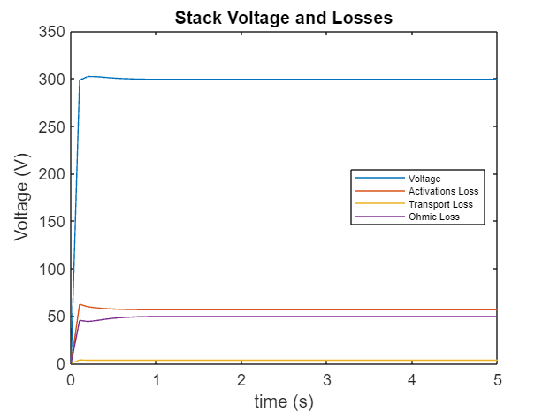
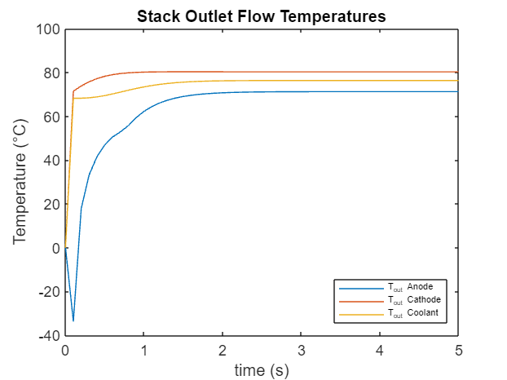
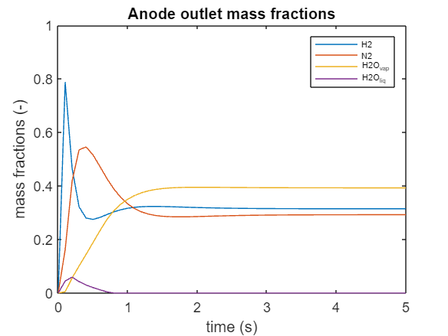
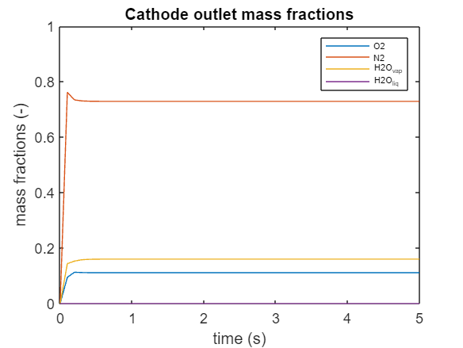

Slide 7
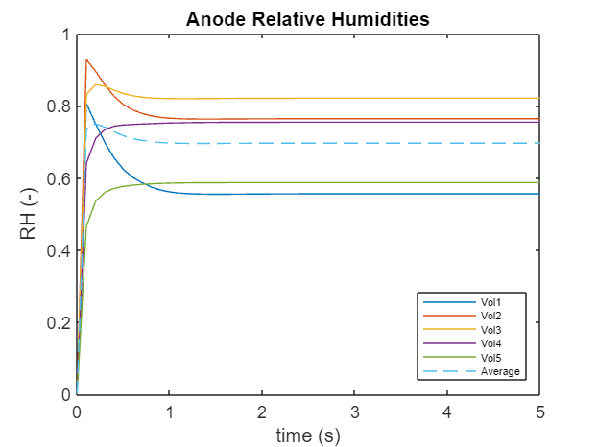
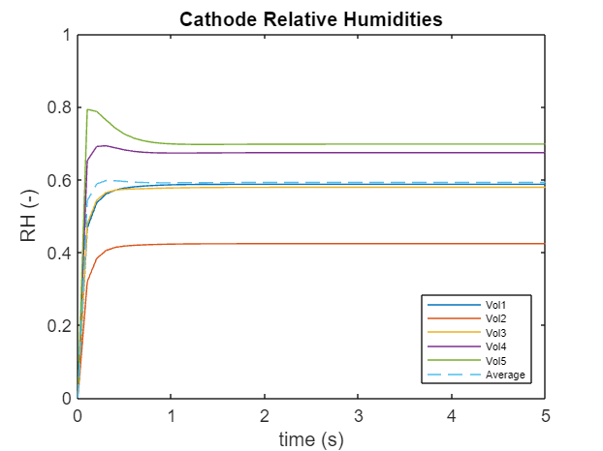
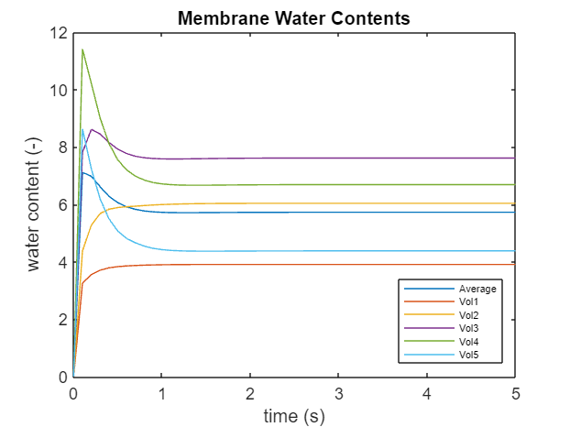
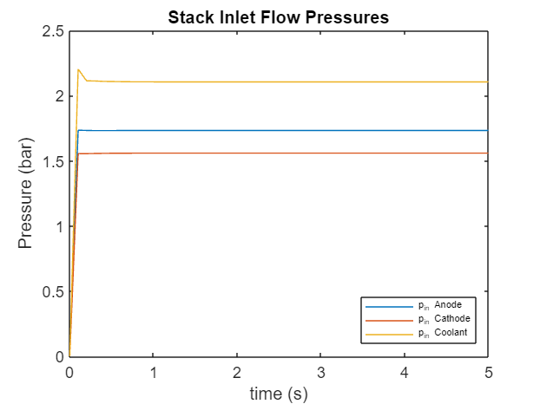

Slide 8
Conclusions Steady Model
All outputs reached converged after about 2s
Anode outlet mass fractions took the most time – 3-4s
First time step in simulation can significate a big jump in the plots because all variables are initialized with 0
Relative discrepancies with Power Cell data do not exceed order of E-02
It can be assumed that the output values will remain the same after the simulated 5s for further comparisons with transient model

Slide 9
Transient Model - Simulink

Slide 10
Outputs (5s Simulation, 15min real time)
N°c | Prameter | Unit | Value | PC_data | Rel. discrepancy
1 | Anode inlet pressure (bara) | Bar | 1,734495649 | 1,7335324 | 5,5566E-04
2 | Anode outlet flow rate (g/s) | g/s | 0,517100124 | 0,50116557 | 3,1795E-02
3 | Anode Outlet H2 mass fraction | - | 0,307676687 | 0,3198664 | 3,8109E-02
4 | Anode Outlet N2 mass fraction | - | 0,287224001 | 0,27969456 | 2,6920E-02
5 | Anode Outlet H2O VAP mass fraction | - | 0,405099312 | 0,40043905 | 1,1638E-02
6 | Anode Outlet H2O LIQ mass fraction | - | 6,60303E-35 | 0 | 6,6030E-35
7 | Anode outlet temperature (C) | C | 71,20487894 | 71,18229 | 3,1734E-04
8 | Cathode inlet pressure (bara) | Bar | 1,561039954 | 1,5729285 | 7,5582E-03
9 | Cathode Outlet flow rate (g/s) | - | 103,5424013 | 102,86486 | 6,5867E-03
10 | Cathode Outlet O2 mass fraction | - | 0,110234266 | 0,110976286 | 6,6863E-03
11 | Cathode Outlet N2 mass fraction | - | 0,72400785 | 0,728805 | 6,5822E-03
12 | Cathode Outlet H2O VAP mass fraction | - | 0,165757885 | 0,16021869 | 3,4573E-02
13 | Cathode Outlet H2O LIQ mass fraction | - | 0 | 0 | 0,0000E+00
14 | Cathode outlet temperature (C) | C | 80,11869493 | 78,35527 | 2,2506E-02
15 | Coolant inlet pressure (bara) | Bar | 2,105920305 | 2,1058333 | 4,1316E-05
16 | Coolant outlet temperature (C) | C | 2791,217708 | 2791,1887 | 1,0393E-05
17 | Voltage_V | V | 76,2230473 | 76,28915 | 8,6648E-04
18 | Voltage_Loss_Activation_V | V | 302,4189562 | 300,51062 | 6,3503E-03
19 | Voltage_Loss_Transport_V | V | 56,77041742 | 56,42324 | 6,1531E-03
20 | Voltage_Loss_Ohmnic_V | V | 3,301218594 | 3,2471392 | 1,6654E-02
21 | Anode_Stoichiometric_Ratio | - | 45,87142981 | 48,256977 | 4,9434E-02
22 | Cathode_Stoichiometric_Ratio | - | 1,111303805 | 1,1114777 | 1,5645E-04
23 | Membrane_Water_Content_Average | - | 2,00448855 | 2,0046246 | 6,7868E-05
24 | Membrane_Water_Content_Vol_1 | - | 6,274699744 | 5,898851 | 6,3716E-02
25 | Membrane_Water_Content_Vol_2 | - | 4,100642767 | 3,9399617 | 4,0782E-02
26 | Membrane_Water_Content_Vol_3 | - | 6,763894058 | 6,212211 | 8,8806E-02
27 | Membrane_Water_Content_Vol_4 | - | 8,339627672 | 7,919018 | 5,3114E-02
28 | Membrane_Water_Content_Vol_5 | - | 7,459827464 | 6,941558 | 7,4662E-02
29 | Anode_RH_frac_Vol_1 | - | 4,70900375 | 4,4815054 | 5,0764E-02
30 | Anode_RH_frac_Vol_2 | - | 0,590258032 | 0,56735295 | 4,0372E-02
31 | Anode_RH_frac_Vol_3 | - | 0,798660159 | 0,77607006 | 2,9108E-02
32 | Anode_RH_frac_Vol_4 | - | 0,848868989 | 0,8329201 | 1,9148E-02
33 | Anode_RH_frac_Vol_5 | - | 0,789908955 | 0,7637591 | 3,4238E-02
34 | Cathode_RH_frac_Vol_1 | - | 0,609732334 | 0,5908948 | 3,1880E-02
35 | Cathode_RH_frac_Vol_2 | - | 0,4363795 | 0,42740992 | 2,0986E-02
36 | Cathode_RH_frac_Vol_3 | - | 0,603548146 | 0,5855505 | 3,0736E-02
37 | Cathode_RH_frac_Vol_4 | - | 0,699121717 | 0,68341476 | 2,2983E-02
38 | Cathode_RH_frac_Vol_5 | - | 0,725203271 | 0,707658 | 2,4793E-02
39 | Coolant outlet flow rate (g/s) | - | 0,675215316 | 0,6585728 | 2,5271E-02

Slide 11
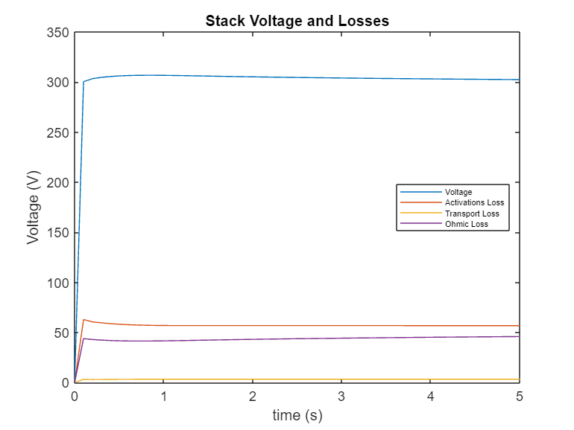
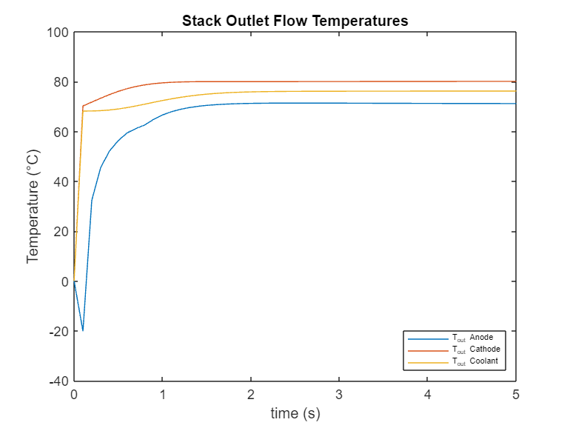
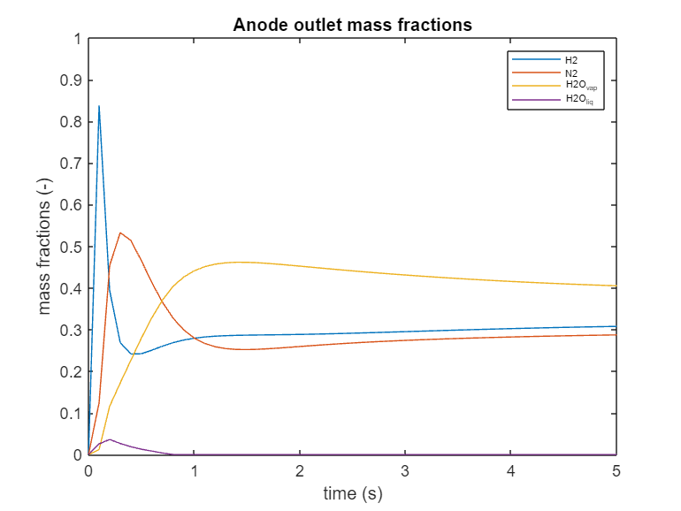
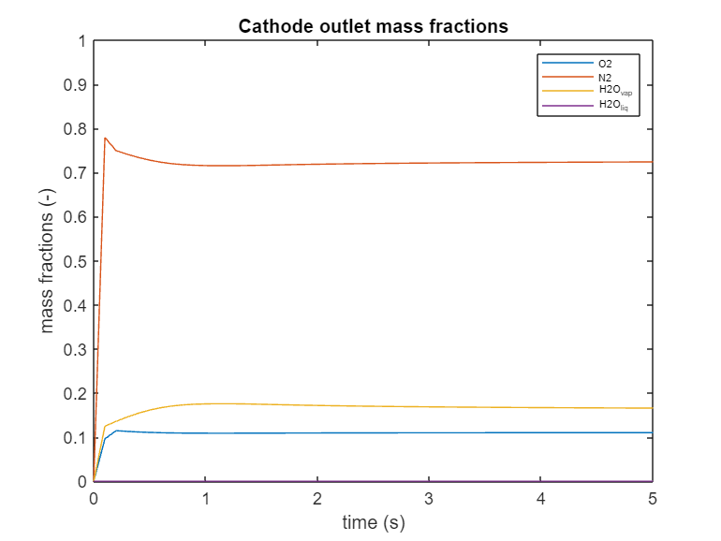

Slide 12
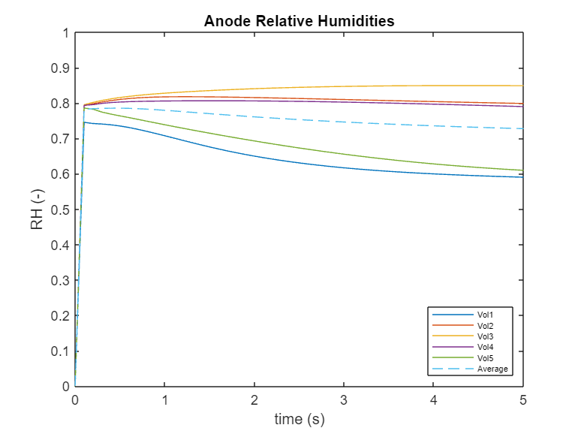
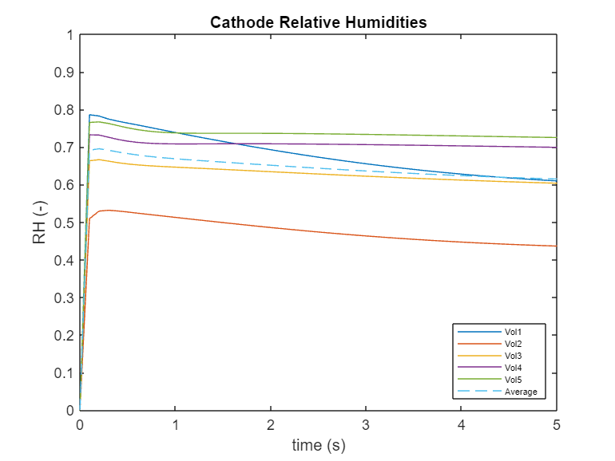
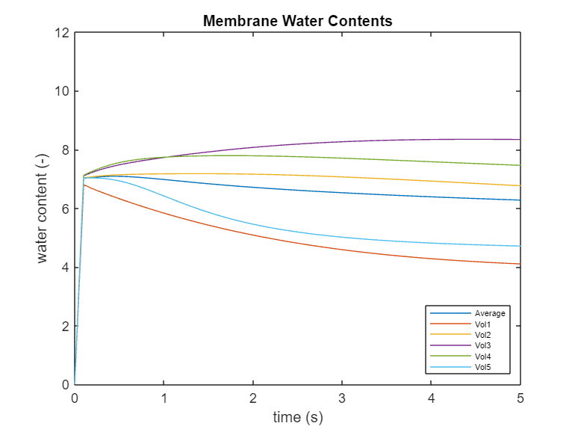
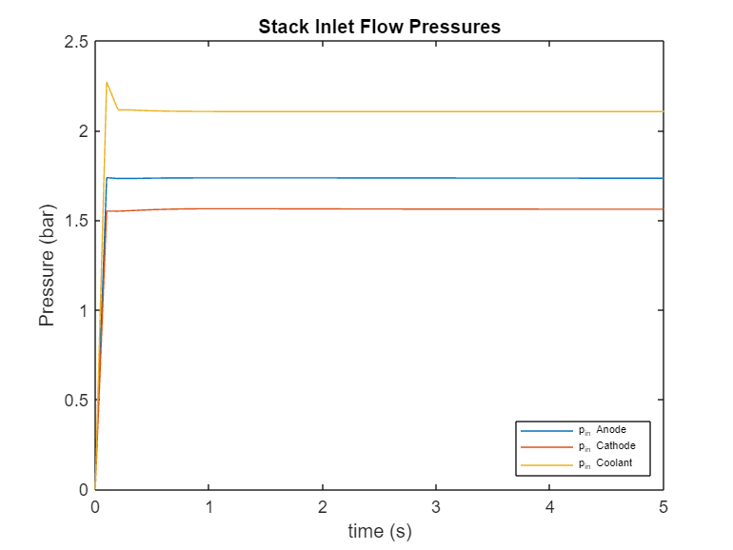

Slide 13
Conclusions Transient Model
Most of outputs have not reached convergence after 5s
Quantities like temperatures and pressures do not seem to change significantly
Other quantities like mass fractions, humidities and voltages are still changing
Relative discrepancies with Power Cell data do not exceed order of E-02
Transient model will be simulated up to 10s to observe further behaviour of curves

Slide 14
Comparison Steady vs Transient for 5s Simulation

Slide 15
Prameter | Unit | pc-stady | pc-tran. | Relative discrepancy
Anode_In_Pressure_bara | Bar | 1,733359715 | 1,734495649 | 6,5527E-04
Anode_Out_Flow_gr_per_sec | g/s | 0,507477629 | 0,517100124 | 1,9200E-02
Anode_Out_H2_mass_frac | - | 0,314684065 | 0,307676687 | 2,1907E-02
Anode_Out_N2_mass_frac | - | 0,292505829 | 0,287224001 | 1,8884E-02
Anode_Out_h2o_vap_mass_frac | - | 0,392810106 | 0,405099312 | 3,0689E-02
Anode_Out_h2o_mass_frac | - | 1,46095E-16 | 6,60303E-35 | 0,0000E+00
Anode_Out_Temperature_C | C | 71,24813637 | 71,20487894 | 6,0770E-04
Cathode_In_Pressure_bara | Bar | 1,559135048 | 1,561039954 | 1,2111E-03
Cathode_Out_Flow | - | 102,8660941 | 103,5424013 | 6,5747E-03
Cathode_Out_O2_mass_frac | - | 0,110980592 | 0,110234266 | 6,7251E-03
Cathode_Out_N2_mass_frac | - | 0,728800543 | 0,72400785 | 6,5761E-03
Cathode_Out_h2o_vap_mass_frac | - | 0,160218865 | 0,165757885 | 3,4572E-02
Cathode_Out_h2o_mass_frac | - | 0 | 0 | 0,0000E+00
Cathode_Out_Temperature_C | C | 80,28137375 | 80,11869493 | 2,0762E-03
Cool_In_Pressure_bara | Bar | 2,105721072 | 2,105920305 | 9,4610E-05
Cool_Out_Flow_gr_per_sec | C | 2791,185945 | 2791,217708 | 1,1380E-05
Cool_Out_Temperature_C | V | 76,33272709 | 76,2230473 | 1,4377E-03
Voltage_V | V | 299,2129872 | 302,4189562 | 1,0668E-02
Voltage_Loss_Activation_V | V | 56,54152674 | 56,77041742 | 4,0567E-03
Voltage_Loss_Transport_V | V | 3,239429551 | 3,301218594 | 1,9029E-02
Voltage_Loss_Ohmnic_V | - | 49,4089595 | 45,87142981 | 7,3306E-02
Anode_Stoichiometric_Ratio | - | 1,111432954 | 1,111303805 | 1,1620E-04
Cathode_Stoichiometric_Ratio | - | 2,004721763 | 2,00448855 | 1,1634E-04
Membrane_Water_Content_Average | - | 5,727727272 | 6,274699744 | 9,2725E-02
Membrane_Water_Content_Vol_1 | - | 3,908780327 | 4,100642767 | 4,8697E-02
Membrane_Water_Content_Vol_2 | - | 6,039553345 | 6,763894058 | 1,1660E-01
Membrane_Water_Content_Vol_3 | - | 7,617577632 | 8,339627672 | 9,1179E-02
Membrane_Water_Content_Vol_4 | - | 6,690807891 | 7,459827464 | 1,1078E-01
Membrane_Water_Content_Vol_5 | - | 4,381917173 | 4,70900375 | 7,2986E-02
Anode_RH_frac_Vol_1 | - | 0,556192135 | 0,590258032 | 6,0044E-02
Anode_RH_frac_Vol_2 | - | 0,764421801 | 0,798660159 | 4,4118E-02
Anode_RH_frac_Vol_3 | - | 0,821159712 | 0,848868989 | 3,3268E-02
Anode_RH_frac_Vol_4 | - | 0,754592573 | 0,789908955 | 4,6240E-02
Anode_RH_frac_Vol_5 | - | 0,586973702 | 0,609732334 | 3,8516E-02
Cathode_RH_frac_Vol_1 | - | 0,423651864 | 0,4363795 | 2,9779E-02
Cathode_RH_frac_Vol_2 | - | 0,578629736 | 0,603548146 | 4,2556E-02
Cathode_RH_frac_Vol_3 | - | 0,673994168 | 0,699121717 | 3,6768E-02
Cathode_RH_frac_Vol_4 | - | 0,697406258 | 0,725203271 | 3,9280E-02
Cathode_RH_frac_Vol_5 | - | 0,649143632 | 0,675215316 | 3,9588E-02

Slide 16
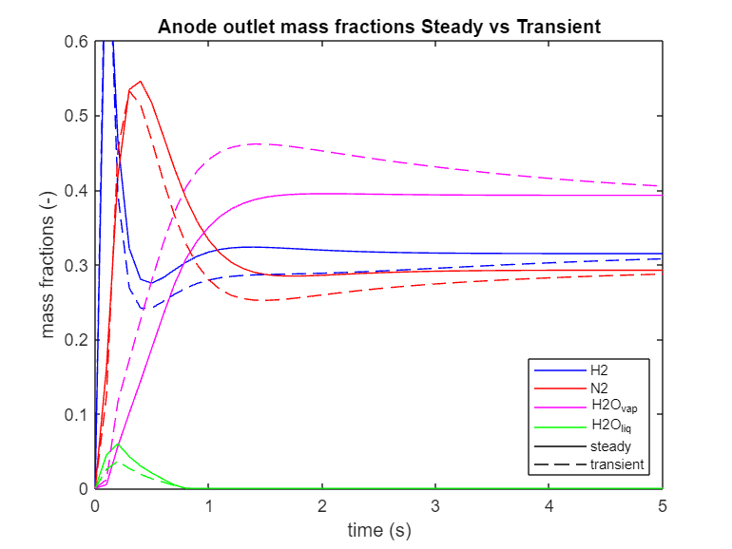
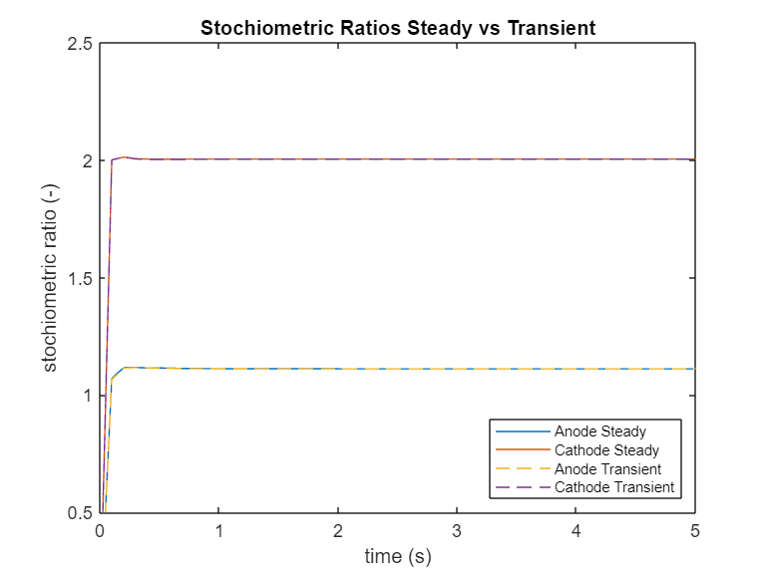
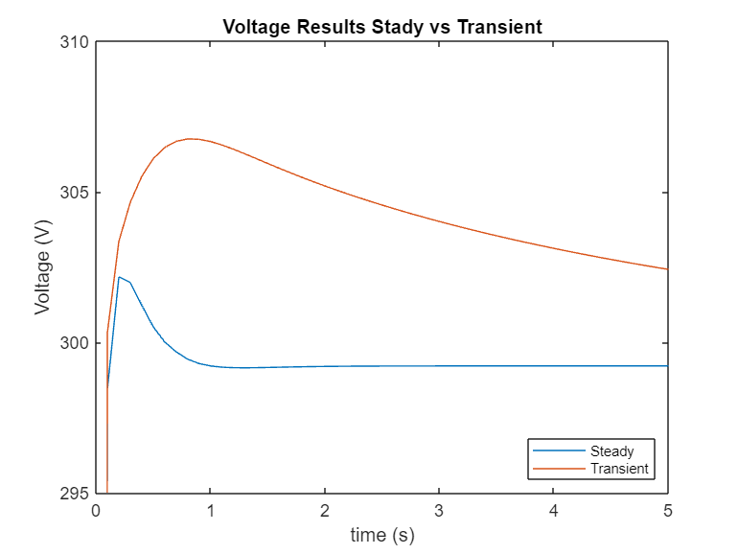
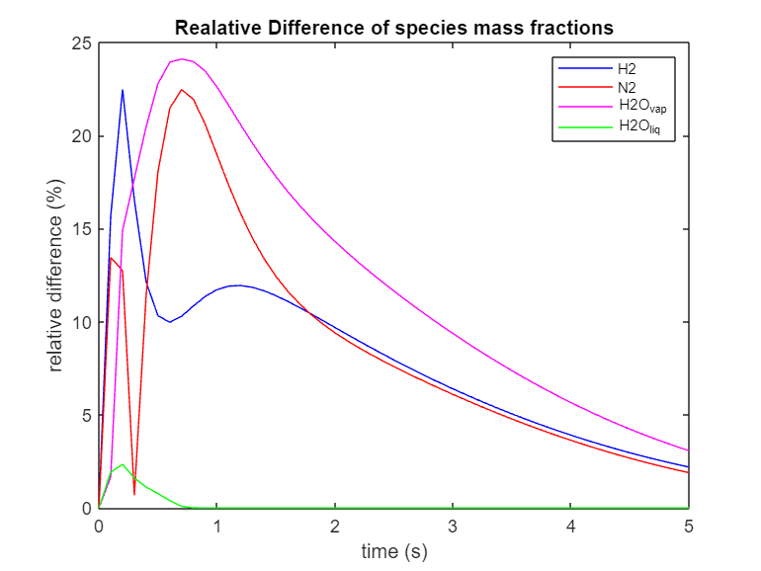
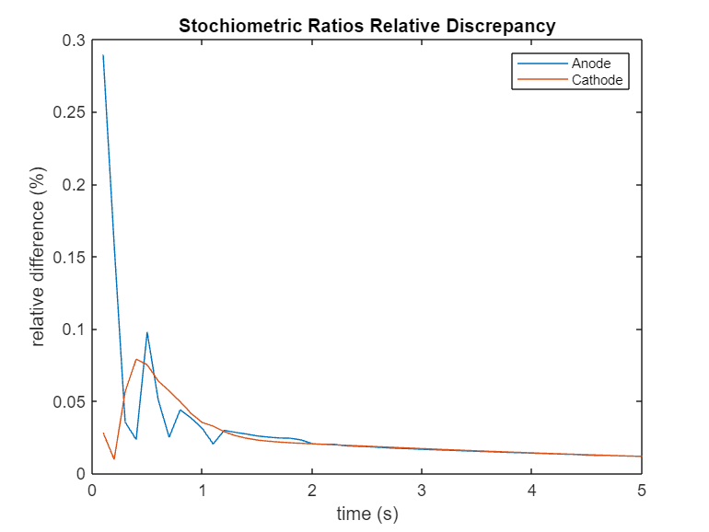
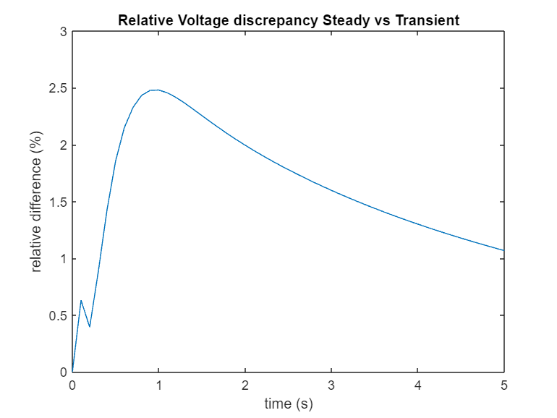

Slide 17
Comparison Steady vs Transient for 10s Simulation

Slide 18
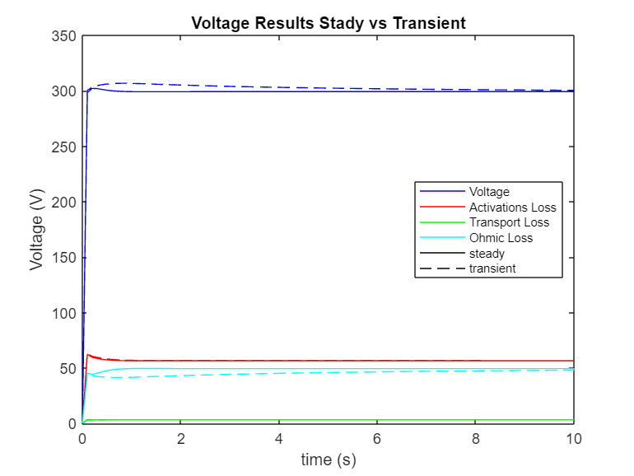
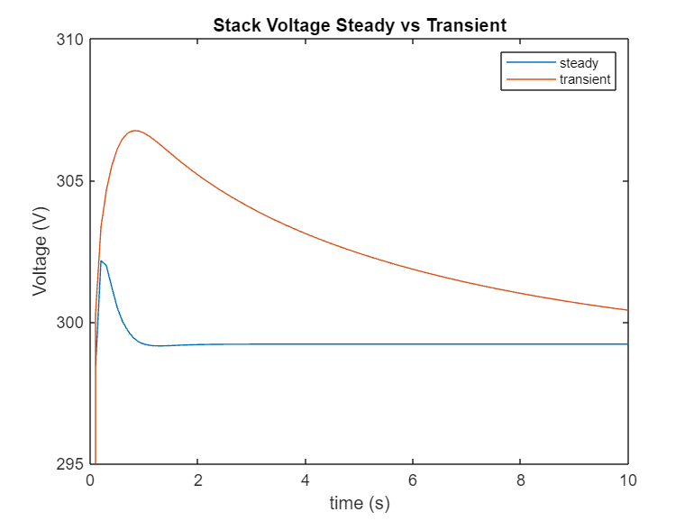
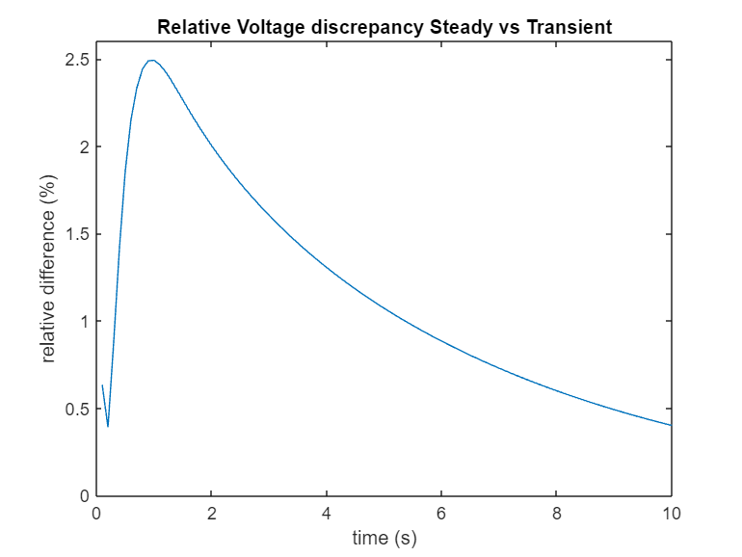
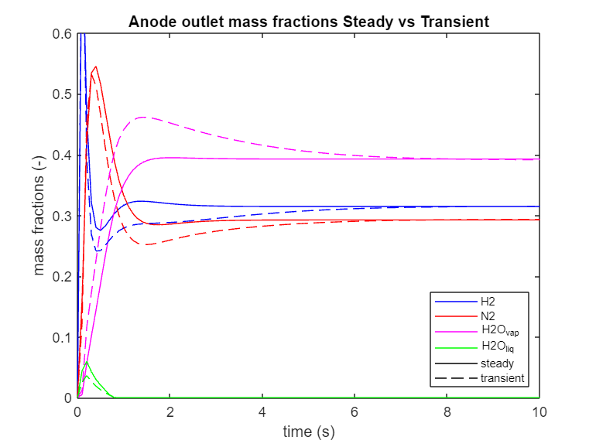
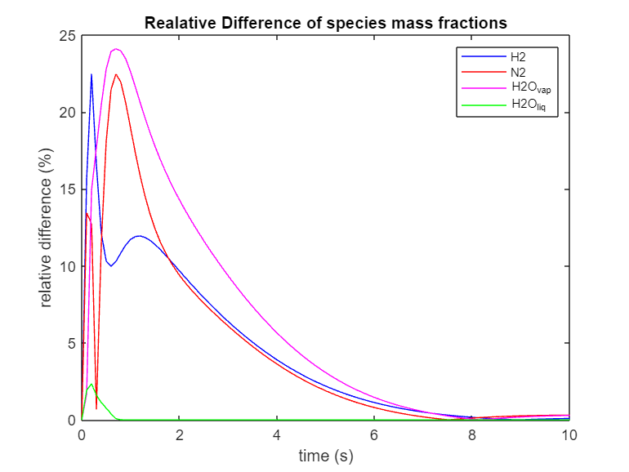
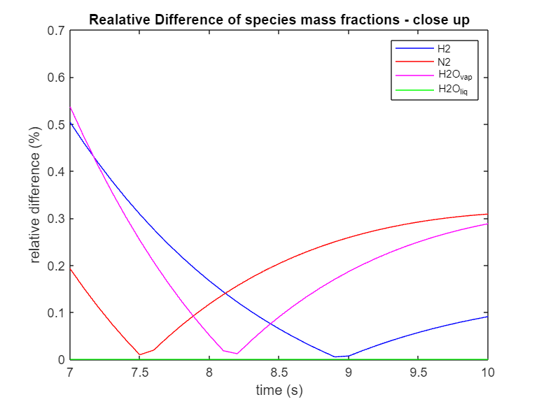

Slide 19
Time step size Analysis

Slide 20
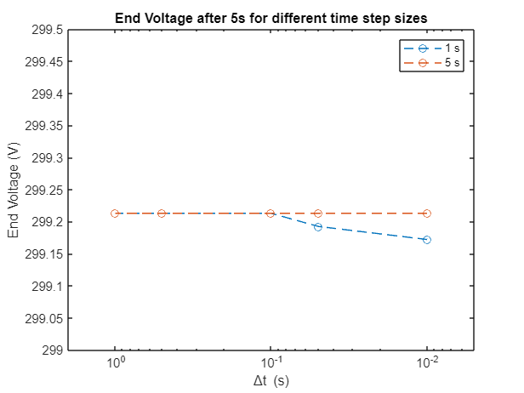
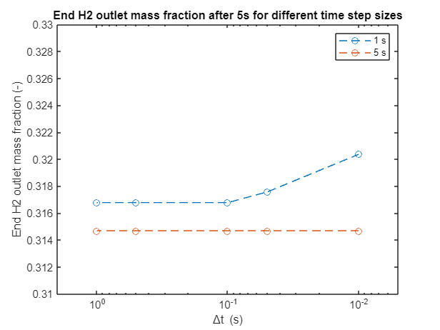
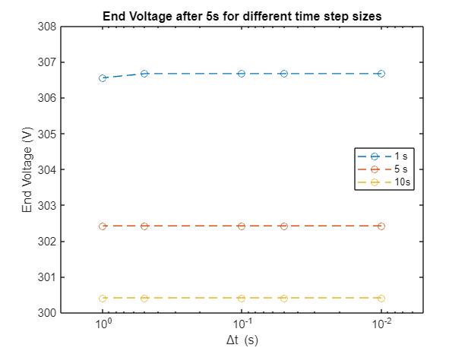
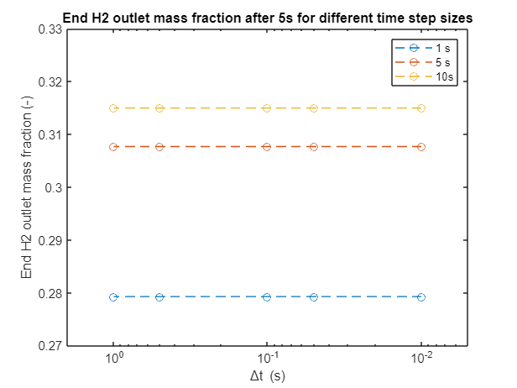


Steady Model
$$y_{i,steady}=f(∆t)$$
Results change for time step sizes smaller than 0.1s, meaning that a smaller end-voltage for even finer discretizations (<0.01s) could be expected
Transient Model
$$y_{i,transient}≠f(∆t)$$
There are no meaningfull changes of the simulation results by altering the time step size. The results are also consisten for any time step size <= 0.1s

Slide 21
Output variation with different operating current

